Slide 1


A regional e-infrastructure initiative in Auvergne
V. Breton
CNRS-IN2P3
LPC Clermont-Ferrand, IdGC
LifeWatch Structural Funds workshop, May 15th 2014
Credit: C. Marechal, S. Brétesché, W. Los, France-Grilles

Slide 2
Table of Content
Regional context
Articulation with national context
Articulation with international context

Slide 3
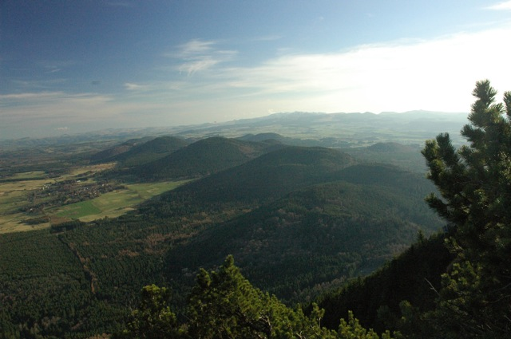
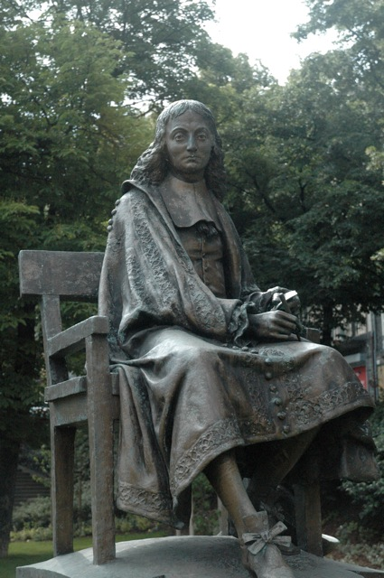
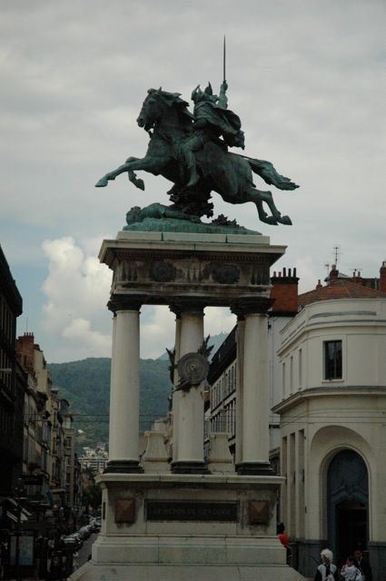
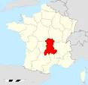


Welcome to Auvergne, at the heart of France
1,35 Million inhabitants
26013 km²

Slide 4
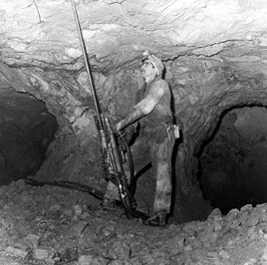
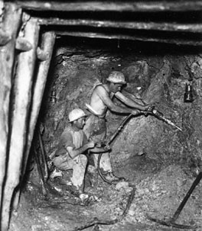
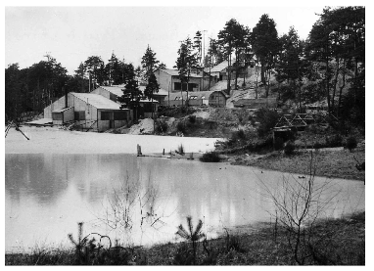
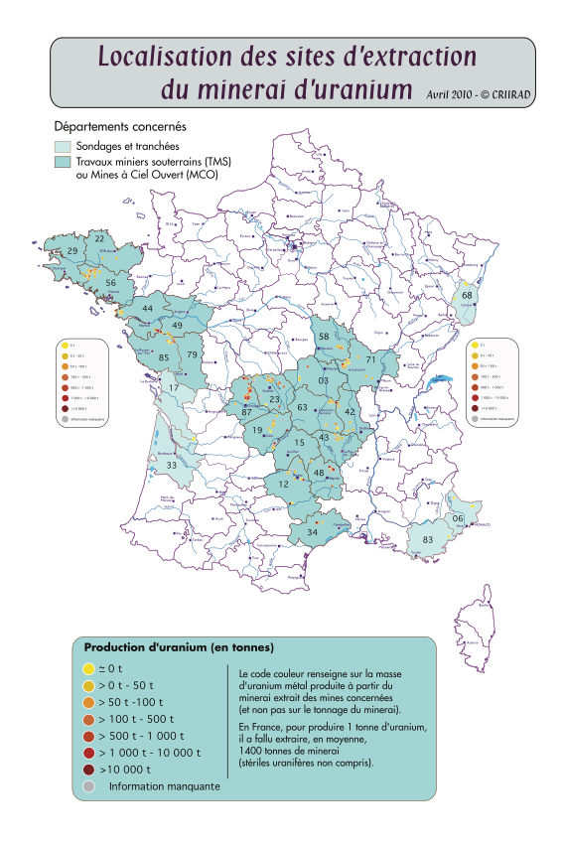
Auvergne at the heart of Uranium production in France
Map of uranium mines in metropolitan France
1949: first attempt to extract uranium ore in France in
Lachaux (Auvergne)
In 50 years:
- 53 Million tons extracted in France till 2001
- 76000 tons of uranium ore produced in > 200 mines
Notes:
http://www.forez-info.com/encyclopedie/le-saviez-vous-/148-quand-la-loire-produisait-de-luranium.html

Slide 5
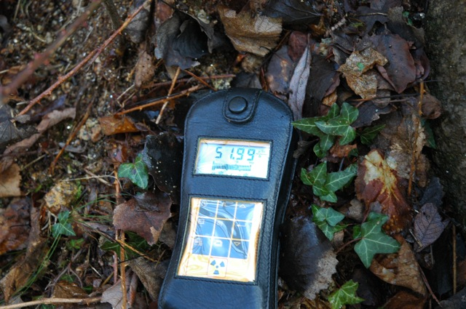
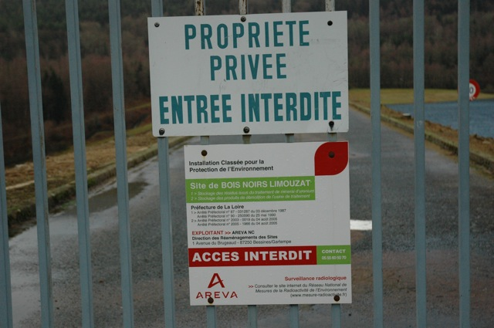
ZATUR, a Long Term Ecological Research dedicated to life under natural ionizing radiation
Society in uranium rich territories
  Social impact of uranium extraction
  Preserving the long term memory
Characterization, behavior and transfer of radionucleids
  long term future of radionucleids in storage sites
Impact of radiation on living systems
  Multigenerational effects of chronic exposure to radiation
Natural radioactivity
Storage sites of uranium
ore extraction residues
Notes:
Liste des partenaires

Slide 6
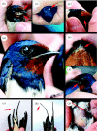
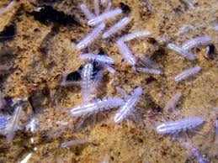
Impact of chronic exposure to low dose ionizing radiation on living organisms
From the Chernobyl environment, a coherent picture of predictable radiation-induced effects for low-dose-rate exposures has not emerged
  Contradictory experimental evidences from Chernobyl exclusion zone
Need to collect more data from Chernobyl exclusion zone but also from other ecosystems under chronic low dose exposure
Photographs of abnormalities in barn swallows. (a) Normal phenotype. (b–d) Partially albinistic plumage. (e) and (f) Deformed beak. (g) Deformed air sacks. (h) and (i) Bent tail feathers.
Proasellus cavaticus
Notes:
Small crustacean from isopod family, found in hundreds of springs across Europe (LEHNA)

Slide 7
ZATUR strategy
Significant production of scientific data (geography, ecology, biology, metagenomics, chemistry, physics, social sciences)
Multidisciplinary long term observation of selected sites in Auvergne, Massif Central and Massif Armoricain

Slide 8






AUDACE, a regional e-infrastructure
Horizon 2020
AUDACE
Budget: 7 Millions €
(Contrat de Projet
Etat-Region 2014-2020)
Research in
computer
science
Regional
IT resource
center
User
communities
AUVERGRID (2007-2013) – LIFEGRID (2006-2010)
INSTRUIRE (2005-2007)
ACI GRID (2002-2005)
Notes:
Le nouveau bâtiment du CRRI est doté de trois salles, correspondant aux diverses activités du service :
une salle technique d’hébergement matériel, avec une surface de 170m2 et une capacité de 60 racks
une salle réseau dédiée à l’exploitation des liaisons inter-universitaires et métropolitaines
une salle opérateur, à disposition des divers opérateurs travaillant en collaboration avec le CRRI et bénéficiant de son infrastructure (Renater, Auverdata, ClermontCo Networks, Orange, SFR, Completel, ...)
L’infrastructure électrique redondée, d’une puissance maximale de 500kVA, permet d’offrir une alimentation en énergie stable aux serveurs. Deux onduleurs de 250kVA et un groupe électrogène complètent cette installation.

Slide 9
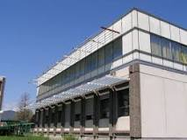
AUDACE objectives
Generic Research activities on Open Research Data
Life and Health sciences
Microbiome
Geospatial data
Astrophysics (LSST)
Axis I – EPICURE
Biomedical sciences
Axis II – SYMBIOSE
Environmental sciences
Axis IV – ATTRIHUM
Social sciences
Axis III MMaSyF
Engineering sciences
CRII – regional IT computing center
A completely new
170 m² technical room
500KVA electrical power
capacity
Notes:
Liste des partenaires

Slide 10
How do the regional initiatives fit in the national context?
ZATUR, one of the 13 members of the French network of Zones-Ateliers
AUDACE, a node of France Grilles, the National Grid Initiative

Slide 11
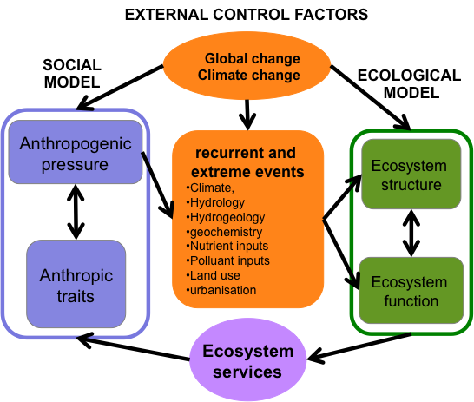
Conceptual model scheme
11
An iterative framework bridging the social and natural sciences
Integrates the biophysical
and social sciences through an understanding of how human behaviors affect dynamics and ecosystem processes. Such dynamics and processes influence also ecosystem services –thereby altering human behaviors and initiating feedbacks that impact the original dynamics and processes.
SL Collins et al . A framework for social–ecological research
Notes:
Application of this approach will bridge the social and natural sciences and build a knowledge base that can be used to help solve current and future environmental challenges; Learning how to manage feedbacks between ecosystems and humans is vital if we are to move toward a more sustainable world; Understanding the drivers and
interactions between sudden events (“pulse” dynamics)
and extensive, pervasive, and subtle change (“press” dynamics) is therefore one of the most important challenges for social–ecological science. We propose that press–pulse dynamics and ecosystem
services can form the critical linkage between social and biophysical domains and serve as the foundation for longterm, integrated, social–ecological research across scales. The PPD framework provides the basis for long-term, integrated, social–ecological research. The right-hand side represents the domain of traditional ecological research; the left-hand side represents human dimensions of environmental change; the two are linked by ecosystem services and by pulse and press events influenced or caused by human behavior (bottom and top, respectively). H1–H6 refer to integrating hypotheses that focus the long-term research agenda. Framework hypotheses: H1 – long-term press disturbances and short-term pulse disturbances interact to alter ecosystem structure and function; H2 – biotic structure is both a cause and a consequence of ecological fluxes of energy and matter; H3 – altered ecosystem dynamics negatively affect most ecosystem services; H4 – changes in vital ecosystem services alter human outcomes; H5 – changes in human outcomes, such as quality of life or perceptions, affect human behavior; H6 – predictable and unpredictable human behavioral responses influence the frequency, magnitude, or form of press and pulse disturbance regimes across ecosystems.

Slide 12
Fondamental missions of the Zones Ateliers Network
- Coordinate long term sustainable LTSER platform;
- Establish a system of banking environmental data
- Build ZA interactions or with other LTER (particularly Europe, USA)
  LTER Mountain initiative (coordinated by ZAA, T. Spiegelberger)
  LTER Marine initiative (coordinated by LTER Italie)

Slide 13
France Grilles, the French National Grid Initiative
Is a Scientific Interest Group…
  Created in 2010 by 8 partners: CEA, CNRS,CPU, INRA, INRIA, INSERM, MESR, RENATER…
  To steer up and coordinate the national strategy in the fields of grids and clouds
Vision:
  Build and operate a national distributed computing infrastructure open to all sciences and to developing countries

Slide 14
France Grilles model
France Grilles does not own the resources
  Resources owned by user communities
France Grilles provides a framework
  To share resources, expertise and know how
  To promote innovation and initiatives
  To foster collaboration at national and international levels
  To reach out to the long tail of users

Slide 15
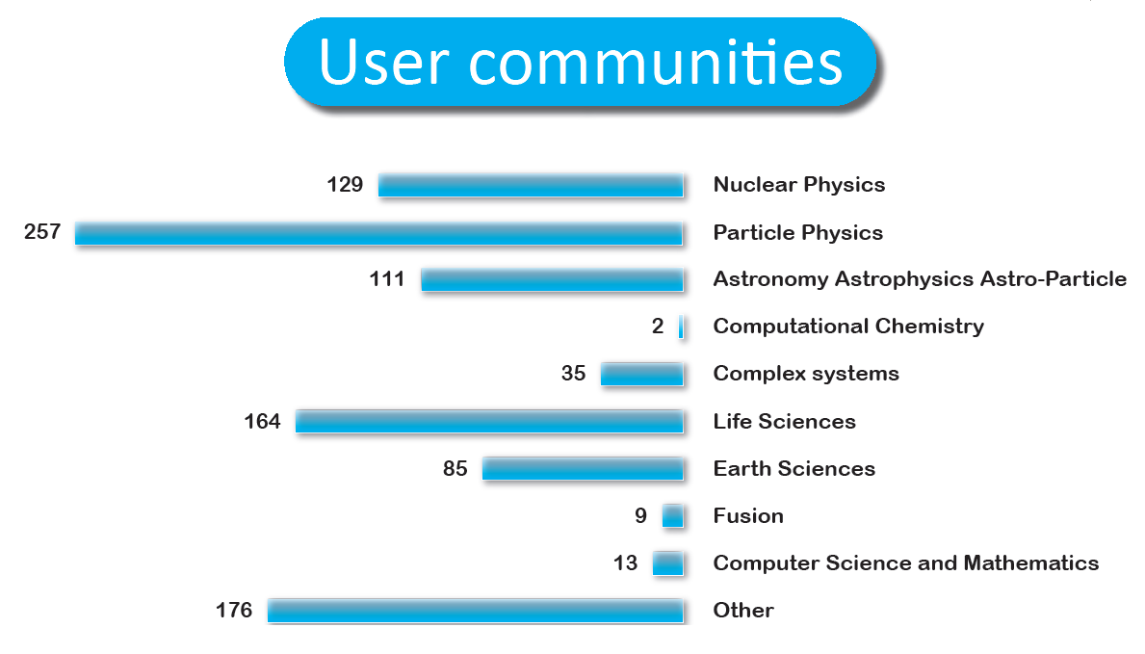
FG provides a common framework to all user communities

Slide 16
FG provides an open environment for fruitful disciplinary and multidisciplinary research

Slide 17
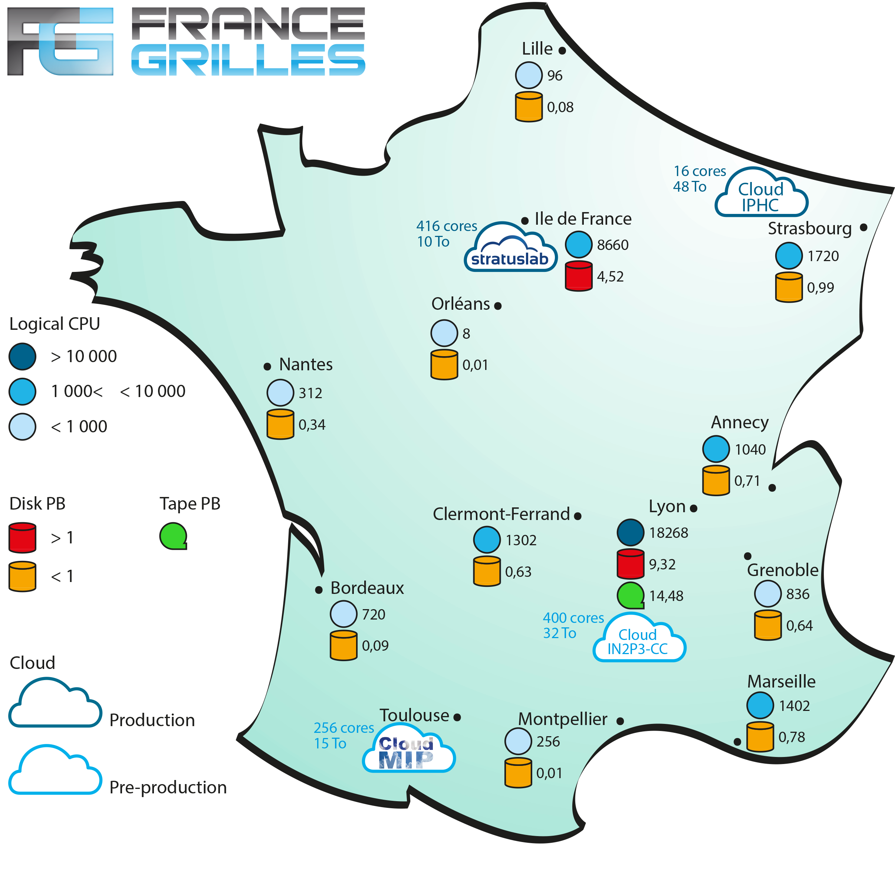
AUDACE will become a new France Grilles resource provider
France-Grilles backbone:
LCG-France
France-Grilles spine:
CC-IN2P3

Slide 18
Where could AUDACE fit in the international context ?
LTER Europe
LifeWatch
EGI

Slide 19




International framework
Long-term research network in environment
Long-Term Biodiversity, Ecosystem and Awareness Research Network
Vice-chair
21 pays
MOU
Ensure a national service of observation and research in environment in an international scientific framework

Slide 20
Structure
LifeWatch is cooperating with “distributed” LifeWatch Centres
in cooperating countries, operating parts of the facilities and services.
LifeWatch
Common Facilities
Distributed
LifeWatch Centre
Distributed
LifeWatch Centre
Distributed
LifeWatch Centre
All together these constitute the “LifeWatch Research Infrastructure”

Slide 21
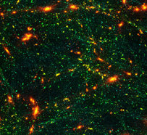
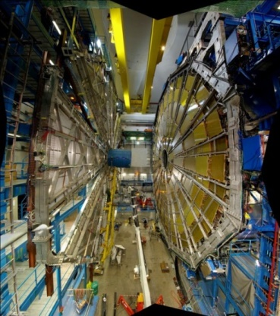
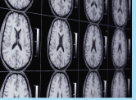
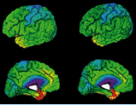
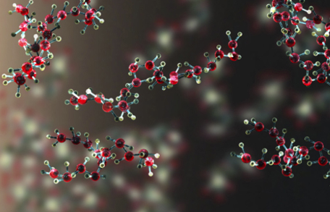
EGI Mission
  MISSION: To support international researcher collaborations from all disciplines with the reliable and innovative ICT services they need to accelerate excellent science
  Natural and physical sciences
  Medical and health sciences
  Engineering and technology
  …
  EC EGI-InSPIRE project (2010-2014)
http://www.egi.eu/case-studies/

Slide 22
The EGI Collaboration
User communities Service Providers Technology Providers
EGI.eu
EGI core services
for federating
Coordination
Communications
Strategy and policy
development

Slide 23
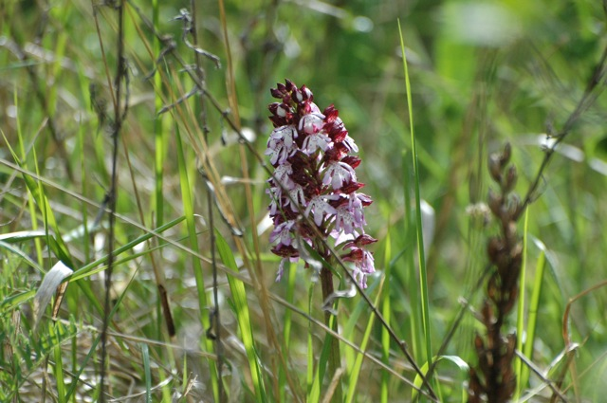
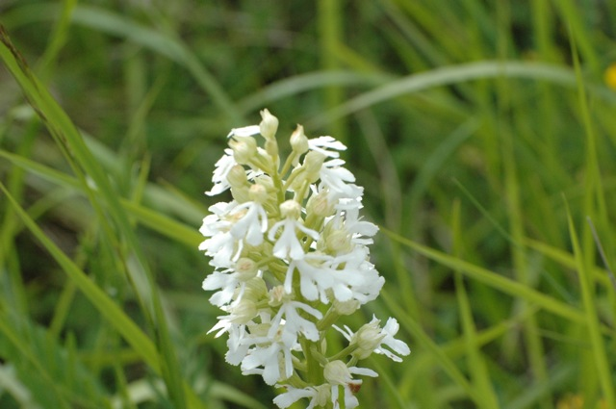
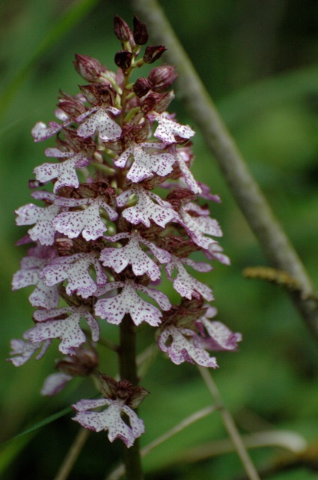
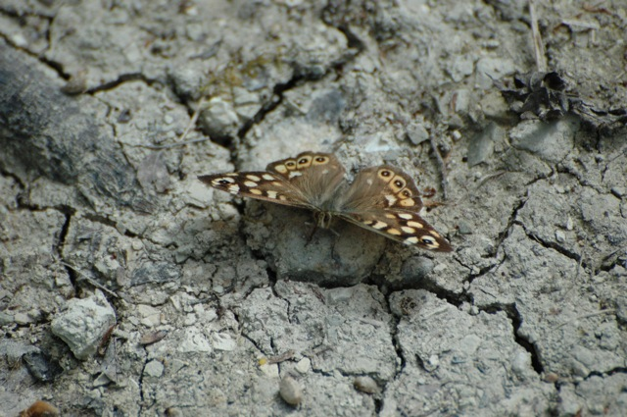
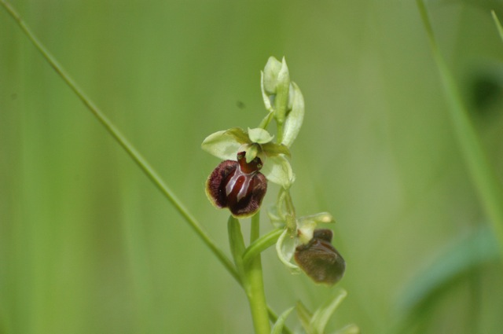
Conclusion
Two regional projects:
  AUDACE, a regional e-infrastructure initiative for Auvergne (2015-2020)
  ZATUR, a Long Term Ecological Research dedicated to life under natural ionizing radiation (2014-2017)
At the intersection of EGI e-Infrastructure and LifeWatch ESFRI
  To provide resources
  To provide use cases
  To bridge cultures

