Slide 1
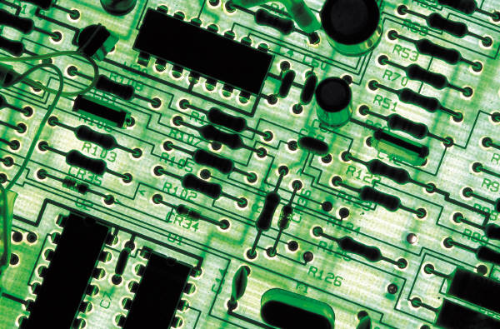
ENX
Driver
GUI
SOAP
Driver

Slide 2
ENX
Driver
GUI
SOAP
Driver
ENX
Driver
SOAP
Driver

Slide 3
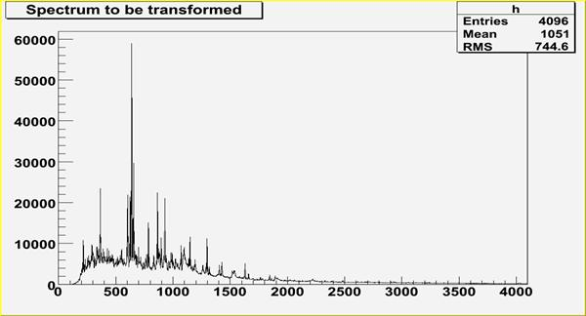
Narval / DCOD
Producteur
Filtre
Consommateur
Code Métier
Consommateur
Consommateur

